Slide 1


How to master
Linear Regression
Anish Mahapatra | 29 January, 2022

Slide 2

Agenda
01
What does Linear Regression really mean?
02
Use-case and concept walkthrough
03
How to assess your linear regression model?
04
Top interview questions and what matters in the industry
05
Key Takeaways

Slide 3











Topic 0 of 6
Introduction
Senior Data Scientist
LinkedIn: www.linkedin.com/in/anishmahapatra Medium: anishmahapatra.medium.com Website: www.anishmahapatra.com
GitHub: www.github.com/anishmahapatra
Q. How to get into Data Science?
A. Simple, ask a real-world Data Scientist.

Slide 4
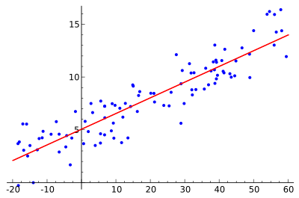
Topic 1 of 6
What does Linear Regression really mean?
Definition of Simple Linear Regression
In this lecture, we will be discussing simple linear regression. Regression is the most commonly used predictive analytics model.
Simple Linear Regression defines a relationship between a dependent variable and independent variable using a straight line. The straight line is plotted on the scatter plot of the two variables.

Slide 5

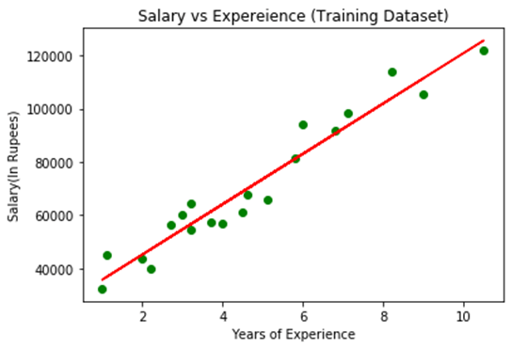


Topic 1 of 6
What does Linear Regression really mean?
Logical Understanding
01
Dependent and independent variable
We have a relationship between two variables. If one increases, there is a visible trend from the data that there might be some relationship.
For e.g. – no of years of experience and salary
02
Fit a straight line through it
Regression is simply establishing a (linear) relationship between the independent variable
03
Iterate to see which line fits best
Fit multiple lines between this set of points to see which line is able to capture the trend of set of points the best. That is, the line which is closest to the points.

Slide 6
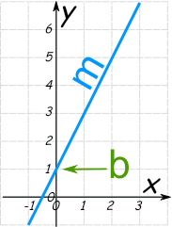

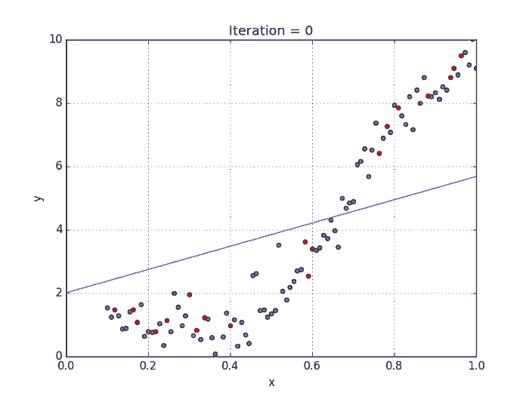
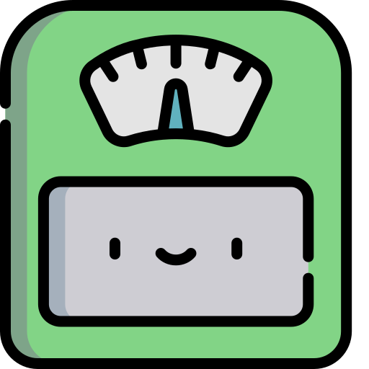

Topic 1 of 6
What does Linear Regression really mean?
Mathematical Understanding
01
Equation of a line
Y = mx + b
x:The independent / predictor variable y:The dependent / target variable m: Slope of the line b: The intercept
02
Best-fit line
Find the line that fits the best. Measure the distance between each point and the line and sum it up. If this number is small, then, we can say that it is the best fit line.
03
Minimize cost function
There are multiple ways to measure what the best line is. For the use case that you select, to get the best fit line, you need to minimize the cost function.

Slide 7
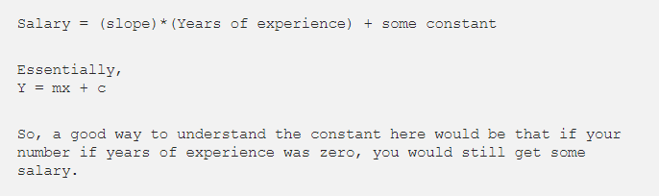
Topic 2 of 6
Use-cases and concept walkthrough
There are two types of linear regression: Simple and Multiple Linear regression. Today, we will talk about simple linear regression.
What do we understand here? X-Axis: Independent variable — Years of Experience Y-Axis: Dependent variable — Salary
We understand that salary is somewhat dependent on the number of years of experience and can be represented as an equation as shown below:
Best fit line
Draw a straight line through the set of points in a way that the line is as close to the points as possible

Slide 8


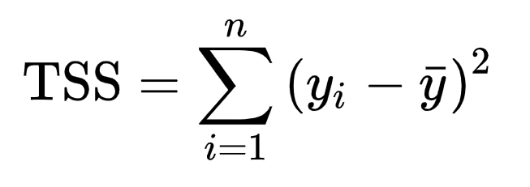
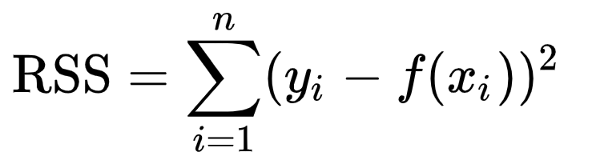
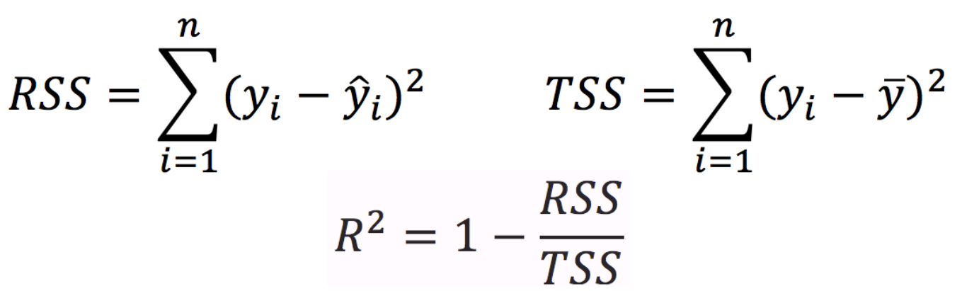

Topic 3 of 6
How to assess your linear regression model?
How to be sure that we have the best model possible?
We need to be better than the mean of the data. We need to be better than the mean of the model. This is called TSS (Total Sum of Squares).
TSS: (Each point – the mean of the entire data)
RSS: Sum of (actual value – predicted value)
Now, we will define the metric that explains what portion of the given data is explained.
This is also known as the coefficient of error.

Slide 9
Topic 4 of 6
Industry Relevance: Linear Regression
Linear regression is a topic one should prepare end to end as interviewers are likely to grill you on the simplest topic.
Simple Questions
List out the critical assumptions of Linear regression?
What is the difference between R square and adjusted R square?
List out the formulas and meaning of RMSE and MSE?
Complex Questions
How to improve the accuracy of a linear regression model?
What are the disadvantages of a linear regression model?

Slide 10
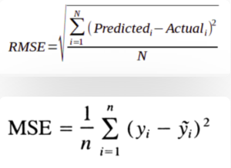
Topic 4 of 6
Industry Relevance: Linear Regression
Linear regression is a topic one should prepare end to end as interviewers are likely to grill you on the simplest topic.
Simple Questions
List out the critical assumptions of Linear regression? - Linear relationship between dependent and independent variable - Independent variable should not have multi-collinearity - There should be an equal distribution of errors (homoscedastic)
What is the difference between R square and adjusted R square? - R square accounts for the variation of all independent variables on the dependent variable - Adjusted R square, it accounts for the significant variables alone for indicating the percentage of variation in the model
List out the formulas and meaning of RMSE and MSE?

Slide 11
Topic 5 of 6
Industry Relevance: Linear Regression
Linear regression is a topic one should prepare end to end as interviewers are likely to grill you on the simplest topic.
Questions
How to improve the accuracy of a linear regression model? - Remove outliers
What are the disadvantages of a linear regression model? - Outliers affect the model

Slide 12
Topic 6 of 6
Key Takeaways
01
Intuition of simple linear regression
02
What linear regression really means?
03
Ways to assess a linear regression model
04
The types of questions that are asked in an interview

Slide 13

How to master
Linear Regression
Anish Mahapatra
Q&A Session
LinkedIn: www.linkedin.com/in/anishmahapatra
Email: anishmahapatra01@gmail.com

Slide 14

How to master
Linear Regression
Anish Mahapatra
Q. How to get into Data Science?
A. Simple, ask a real-world Data Scientist.
Email: anishmahapatra01@gmail.com
Thank you.

